Slide 1

NYC RESTAURANT ANALYSIS
Zhilin (Janine) Wang
Junting Zhao
Preethi Bachu
Sreeja Sriramaneni
Notes:
provide your company profile, business problem being addressed, benefits\disadvantages/challenges and final recommendations.

Slide 2





consulting company
client
restaurant
Notes:
Before we start with the technical part of our project, let me tell you how we places ourselves in the market.
We are a consulting firm, our client in this situation is an organization that wants to open up a new restaurant in NYC.
As any other business, they want their venture to be profitable.
They want to know which cuisine would work best in which area and ideal positioning of the restaurant.

Slide 3

Background
Data Description
Description of the problem and our objectives for the project
Description of the datasets as well as the tools and methodology used
Analysis
Recommendation and Conclusion
Description of our analysis and insights from visualizations
Review and our recommendations
Notes:
For many people, ratings, reviews, and hygienic inspection grades are the decision-making factors to measure the potential success of restaurant businesses in terms of quality and popularity.
The restaurant ratings come from Yelp, as it is usually the first place people go to search for restaurants and to understand the other customers’ experience at each restaurant.
Many consumers also consider inspection grades to understand the sanitary level that each restaurant can provide.
For this project, we would like to observe and examine if there is any correlation between the NYC restaurant reviews/ratings and inspection grades through data analysis and visualizations.
This analysis will be most helpful for anyone who is interested in identifying certain features of NYC restaurants (locations, cuisines, cleanliness, etc.) to filter restaurants that they can enjoy and the ones to avoid.

Slide 4


Slide 5
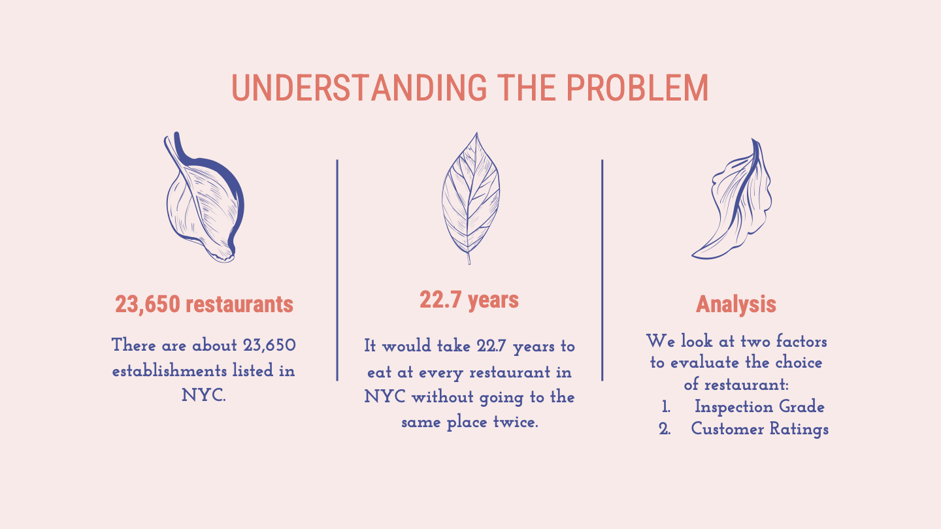

Slide 6


Slide 7
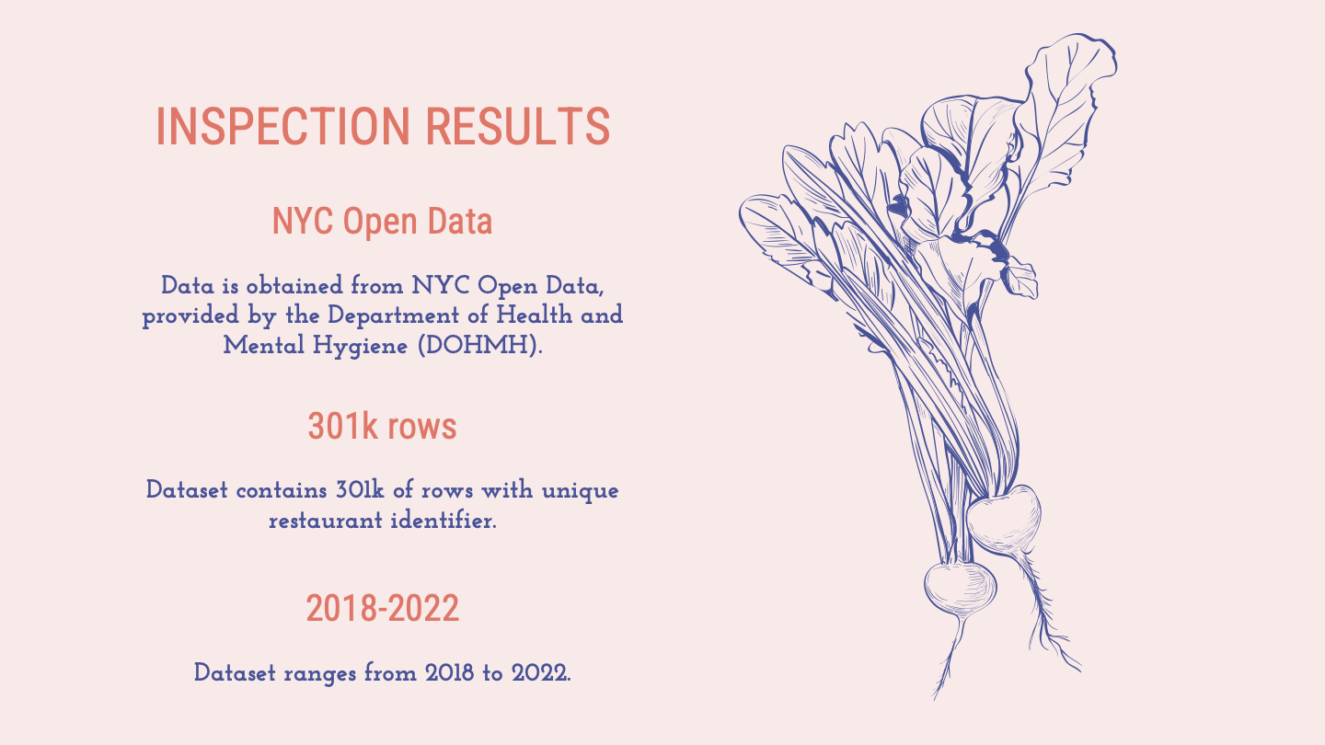

Slide 8
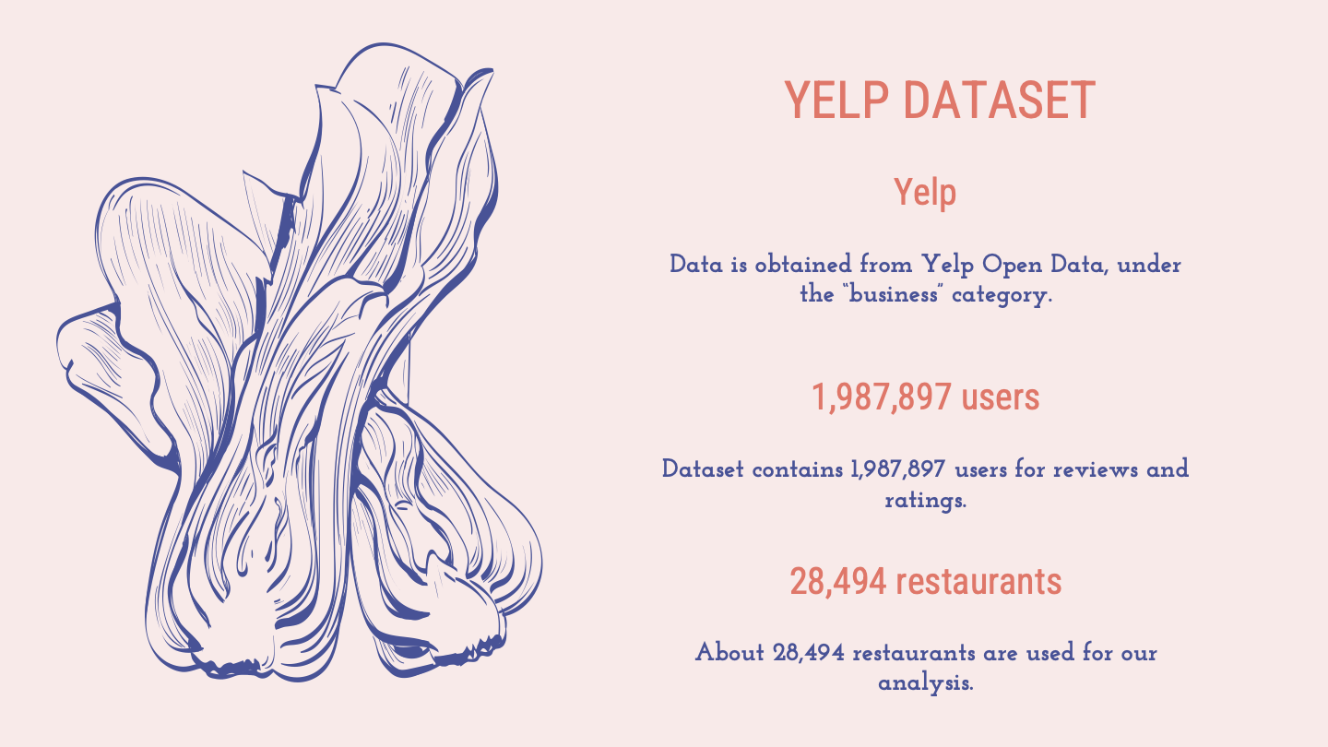

Slide 9
Description
The Restaurant Inspection Results Dataset is obtained from NYC Open Data, provided by the Department of Health and Mental Hygiene (DOHMH).
The supplemental dataset is downloaded from Yelp Dataset, which will be used for user ratings within the same zip code and cuisine.
Dataset
DBA | Name of restaurant
Boro/Borough | Borough in which the restaurant is located
Zip Code | Zip code
Cuisine Description | Cuisine type
Score | Score of a particular inspection; Scores are updated based on adjudication results
Grade | Grade associated with the inspection
Critical Violation | Violation
Rating | Ratings

Slide 10





Tools & Technologies Used
Excel was used to open and extract/filter/clean the relevant data points within the dataset
Python was used to perform data cleaning, create visualizations and conduct analysis
Tableau was used for data visualization

Slide 11


Slide 12

Notes:
The same process was used for both the datasets after importing them. The analysis was conducted on Jupyter Hub on Visual Studio Code using Python.
1.Check for any empty business lists
2.Save the compiled data into dataframe and remove any empty data
4.Sort and drop duplicate values and remove columns that are not necessary
5.Get dummy variables for categorical columns and combine new columns with original dataframe
6. Find the most frequent categories (anything with over a set cap)
7. Identify each restaurant as either being a mainstream or a rare category
8. Check for outliers and replace outlier values in the review_count column (anything above a set cap) with a number
9. Merged the 2 datasets using the restaurant's phone number using the merge function:
df_merged = pd.merge(df_inspec_filtered, df_filtered, on=("phone"))

Slide 13

Exploratory Analysis

Slide 14
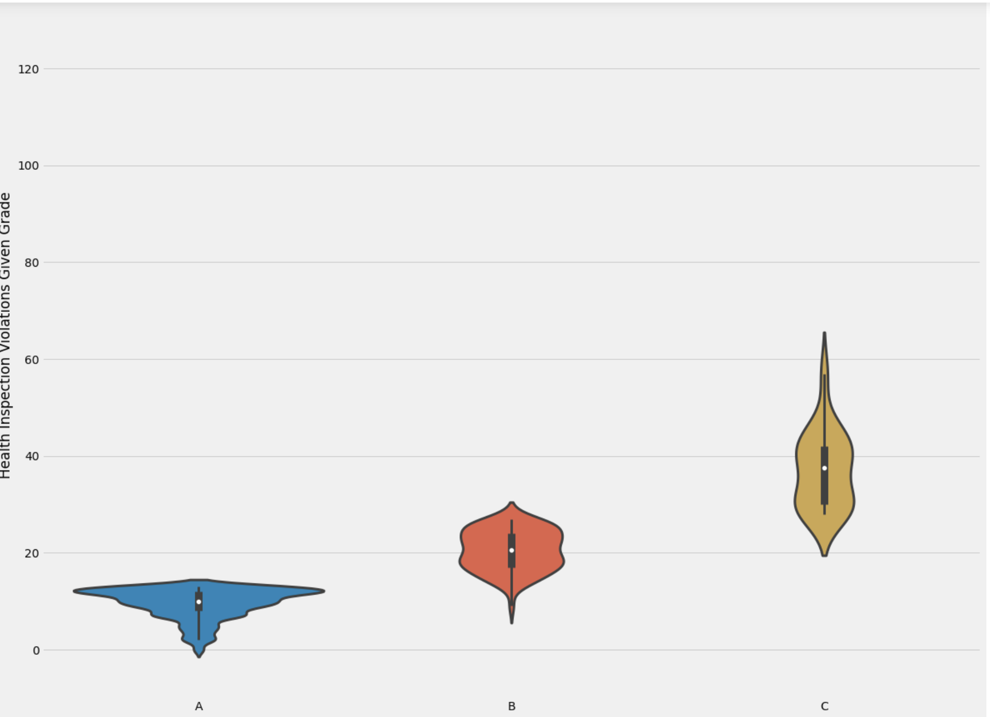
Most A rated restaurants scored less than 20, B rated restaurants scored between 20 and 30 and C rated restaurants scored more than 20.
Notes:
The grades and scores are justifiable. Scores from 0-15 are graded A, 16-30 are graded B and those more than 30 are graded C. This analysis is done using Python pandas.

Slide 15
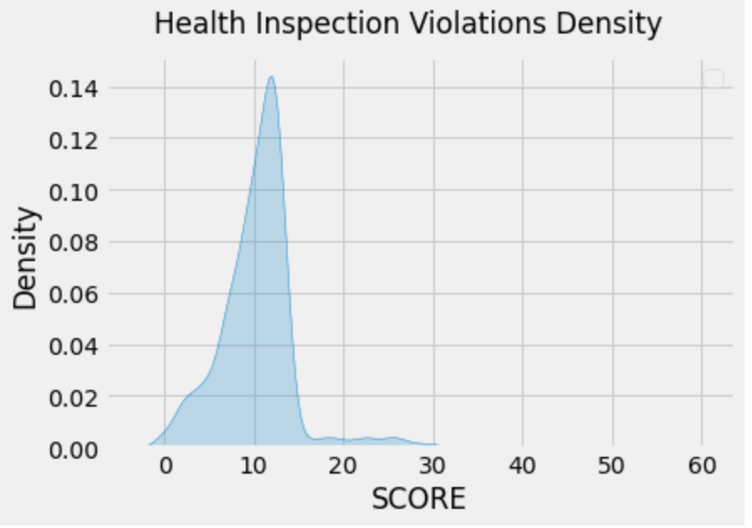
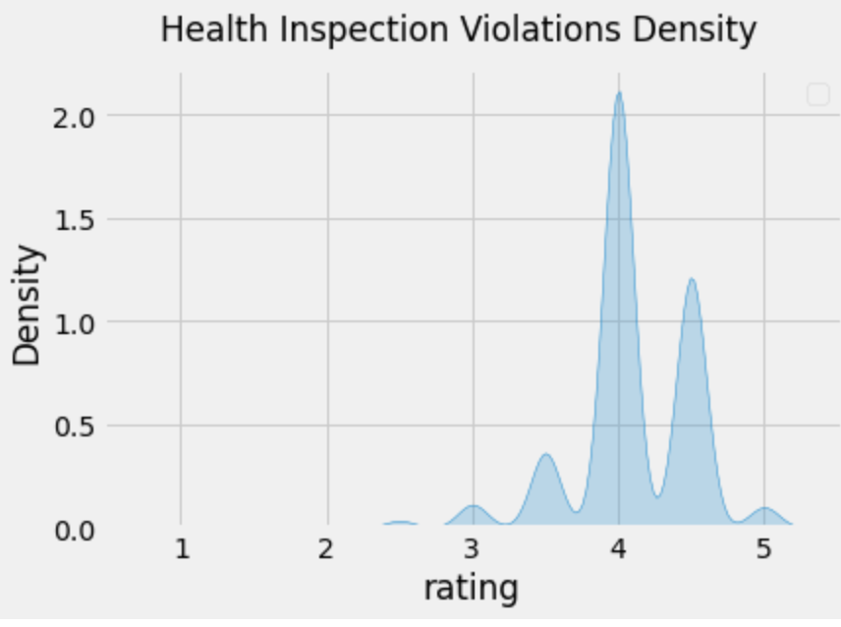
Health inspection violation density charts with scores show that almost all of the restaurants were scored below 30 and ratings show that almost all of the restaurants were rated above 3.
Notes:
Both the charts show that the scores given by the department of health and ratings given by the customers are on the same page. It is quite easy to get and average score and rating but the restaurant needs to have a special factor to really stand out. There are a lot of things that influence the ratings such as location, cuisine, ambience etc., and we will be analyzing all these things.

Slide 16
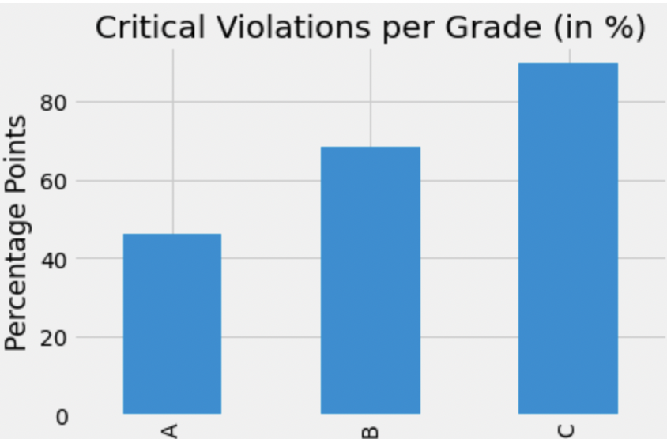
More than 45% of A rated restaurants have one or more critical violations.
Notes:
We need to look at the remaining 55% restaurants and study them. Analyze the differences between both the groups to get a better understanding of how things work. Learn more about the violations and look at ways to avoid them.

Slide 17

Data Visualization—Potential Factors
Notes:
In the next part, we would like to do the data visualization to analyze the potential factors to determine a successful and popular restaurant. We will focus more on the customer rating from the Yelp

Slide 18
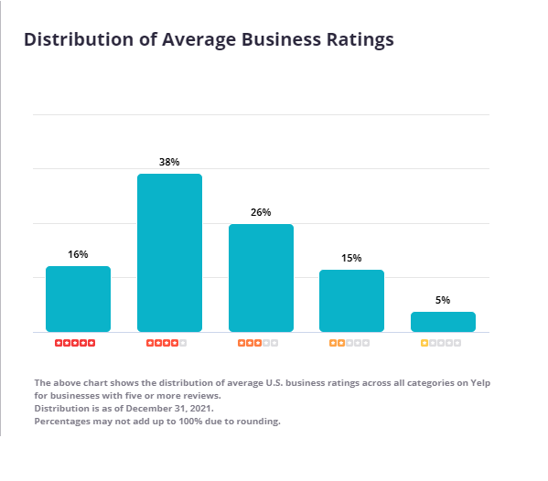
Notes:
The business rating A restaurant must outperform its local competitors in order to increase the Yelp sales. And generally speaking, that indicates that a restaurant require a Yelp star rating of 4.5 or 5.0. Businesses with an average Yelp rating of 4.0 stars or below cannot compete typically with the local competitors.
This is due to the fact that the average Yelp review for a business is based on a 4-star rating that is rounded up to the nearest half star from an overall average of 3.78 stars.
According to the official Yelp information page, the exact distribution of star ratings is as follows:
As a result, any company with fewer than 4.0 stars is below average, any company with 4.0 stars exactly is just "average," and only companies with 4.5 or 5.0 ratings are above average and hence competitive to draw in the majority of sales.

Slide 19
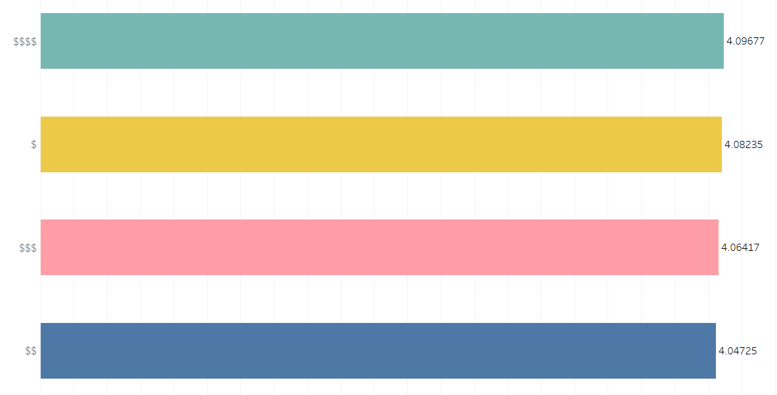
Rating by Price Level
The highest rating:
Price Level 4
Differences between each rating are slight:
No significant relationship between the price and ratings in this dataset
Notes:
First, we will take a look at the price level.
From this horizontal bar chart, the price level of 4 has the highest rating. However, the differences between them are so slight that we can’t find the significant relationship between price and ratings in this dataset

Slide 20
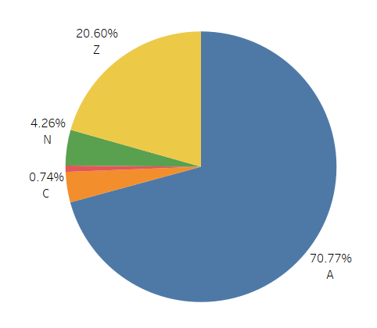
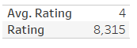
Rating by Inspection Grade
Inspection grade
Health, safety, quality
A > B > C
Among top rating: 4.0 - 5.0
Grade A: 70.77%
Recommendation 1
*N: Not yet graded
Z: Grade pending
Notes:
According to the official Yelp information page, the exact distribution of star ratings is as follows:
The average Yelp review for a business is based on a 4-star rating. Therefore, Any company with fewer than 4.0 stars is below average. Any company from 4.0 stars to 5.0 stars is considered as the average and above and hence competitive to draw in the majority of sales.
The inspection grade represents the health, safety, and quality of a restaurant.The grade A is better than B, and better than C, which means the restaurants whose grade is A will have a higher performance on quality than other restaurants.
We can see from this pie chart that, among the top ratings which are from 4.0 to 5.0 (inclusive), the grade A occupies about 70 percent. Hence, the inspection grade does matter. Also, it brings us to the first recommendation, which is to focus more on quality.

Slide 21
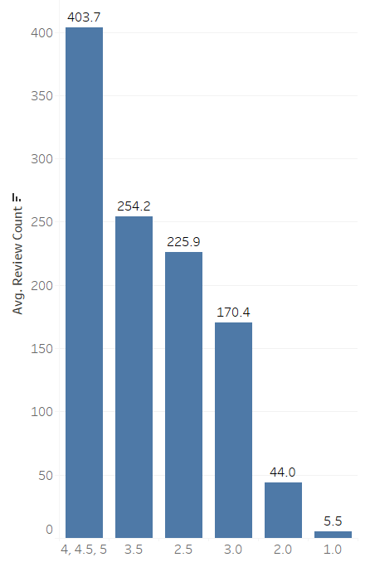
Rating by the Number of Reviews
Top ratings have more reviews
Number of reviews:
Reliability, Reputation
Recommendation 2
Notes:
According to the chart, the average number of reviews of the top ratings which contains the group of 4, 4.5, and 5 is largely greater than that of poor ratings. The reason is that the number of reviews always reflects the reliability and reputation of a restaurant in a sense.
Hence, the number of reviews does matter. It brings us to the second recommendation, which is to pay more attention on the number and also quality of reviews.

Slide 22
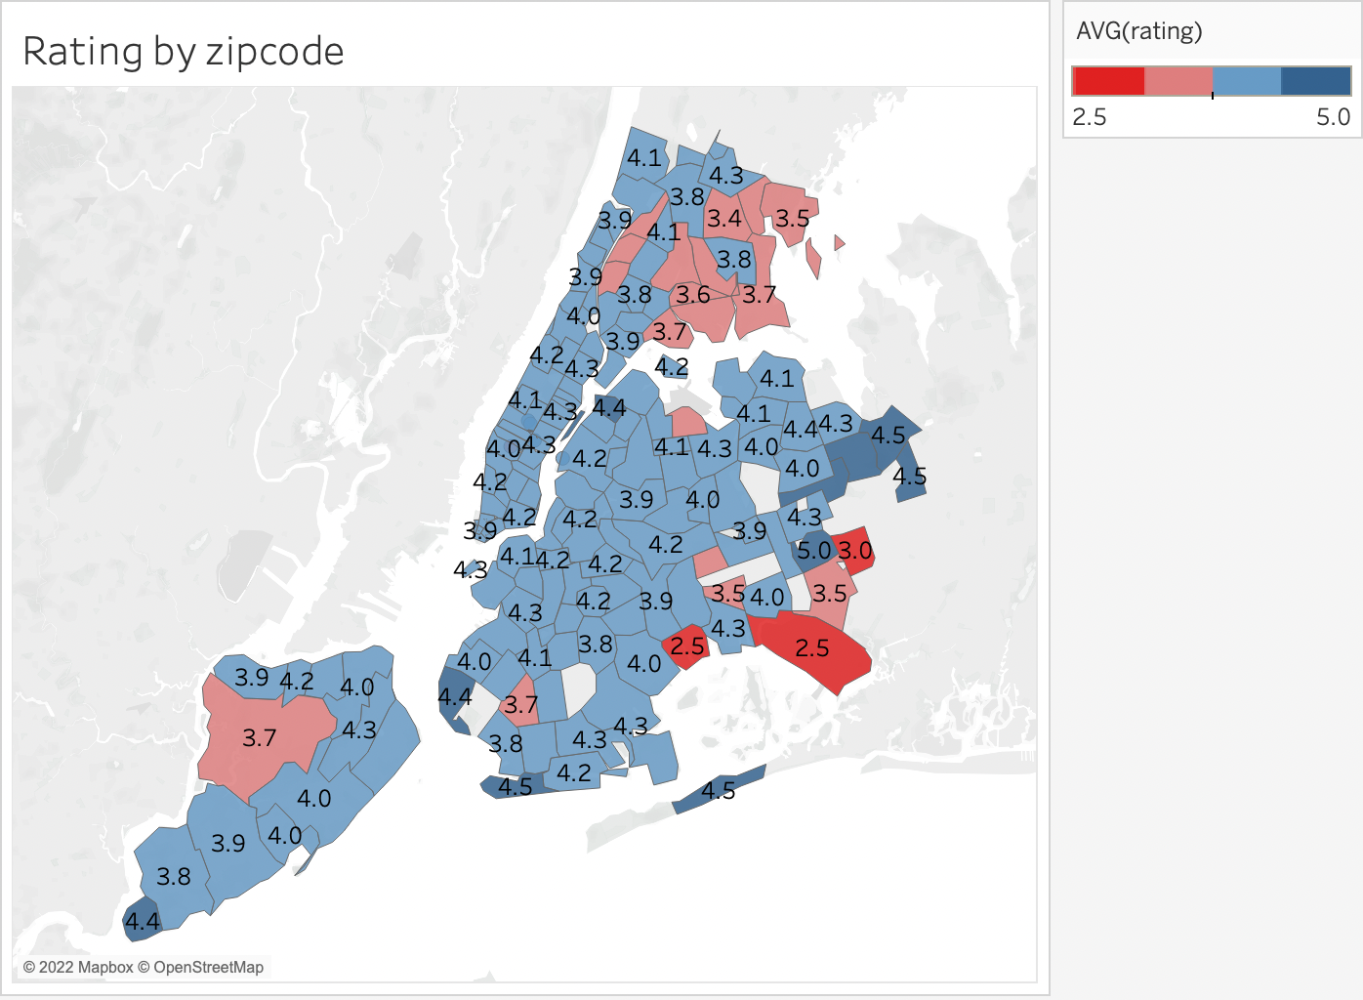
Rating by Zip Code
Average rating by Zip Code is a reflection of the competitors’ situation
Recommendation 3: Locate a restaurant in a relatively low-rated area so there is less competition
Notes:
Average rating varies greatly by zip code from 2.5 to 5.0 as shown on the map.The average rating is a direct indication of the competitor’s situation and impression from customers in the area as ratings are given by the customers directly. In the area where the average rating is comparatively high, the standard is set higher for the restaurants which means a new restaurant needs to perform significantly better to outcompete the local restaurants. Thus, it’s recommended to open a restaurant in a relatively low-rated location where there is less competition.

Slide 23
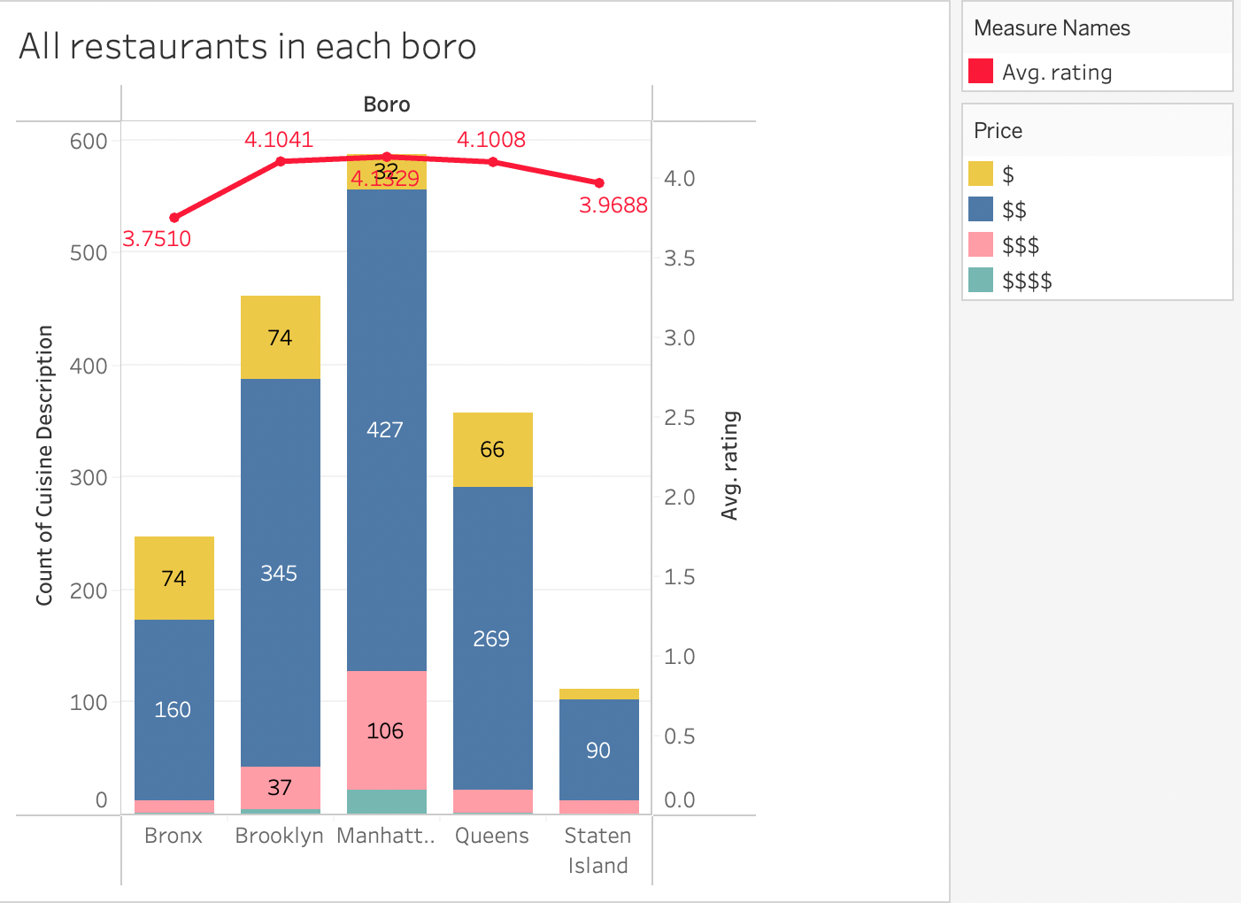
All restaurants in Each Boro
Factors to consider:
Price range
Number of restaurants in the same price range in this borough
Recommendation 4: Locate where there are few existing restaurants because the presence of multiple restaurants in the same price range typically indicates a saturated market.
$ = Inexpensive, usually $10 and under
$$ = Moderately expensive, usually between $10-$25
$$$ = Expensive, usually between $25-$45
$$$$ = Very Expensive, usually $50 and up
Notes:
The price range a restaurant would like to operate in is a different aspect to take into account while choosing a location. Depending on the nature and location of the restaurant, prices can vary greatly. As a result, while deciding where to start a restaurant, it's crucial to consider the menu price as well as the number of restaurants in the same price range. When there are too many similarly priced restaurants in an area, restaurants need more strategies to stand out from the rest. It is advisable to think carefully about what price range a restaurant is going to set, and locate where there are few existing restaurants because the presence of multiple restaurants in the same price range typically indicates a saturated market.

Slide 24
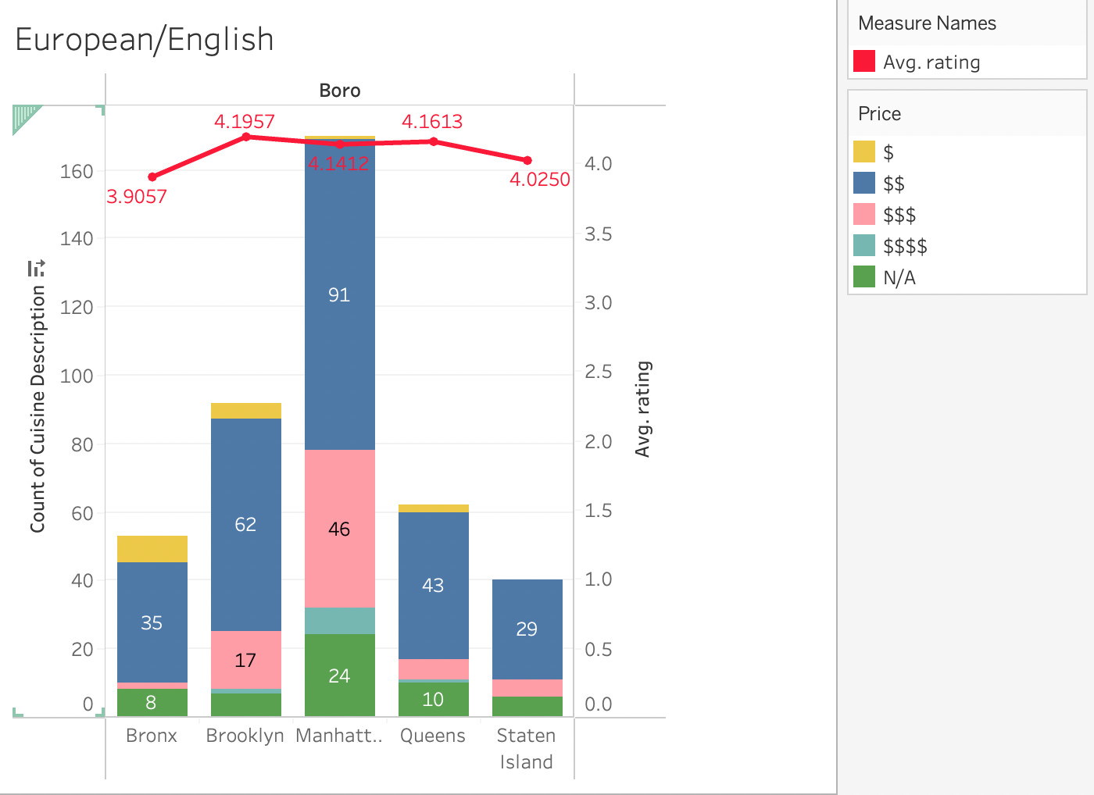

Slide 25
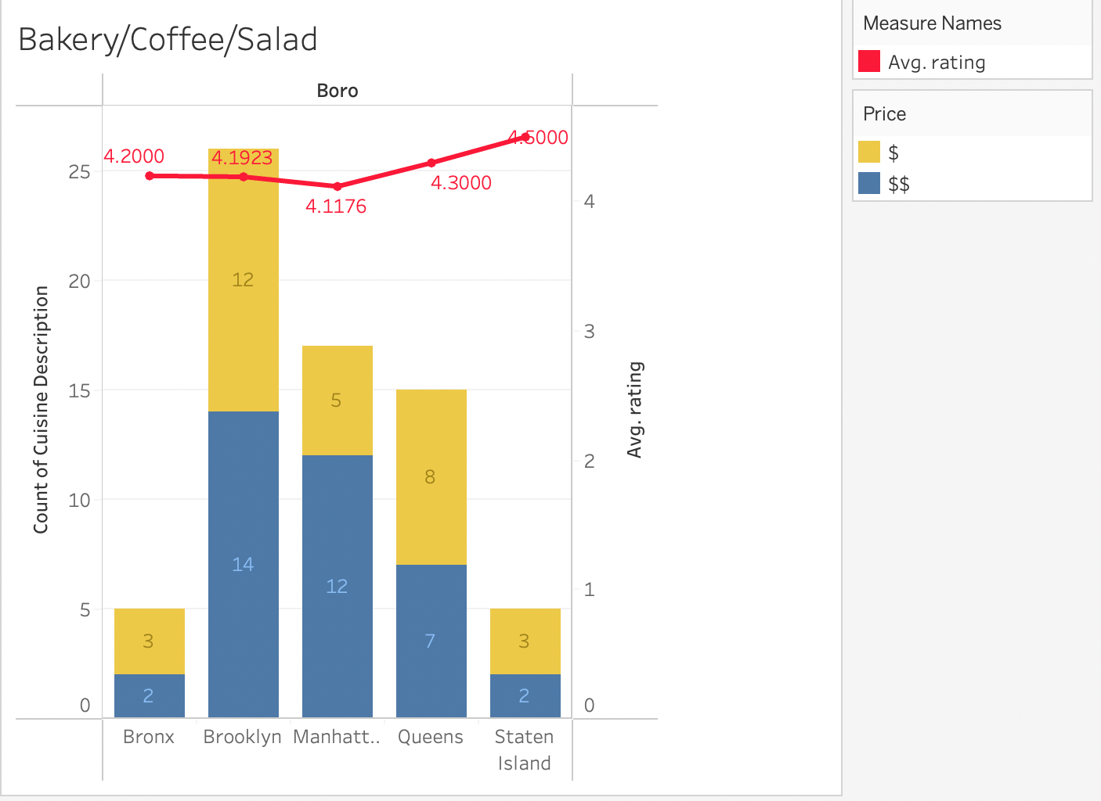

Slide 26
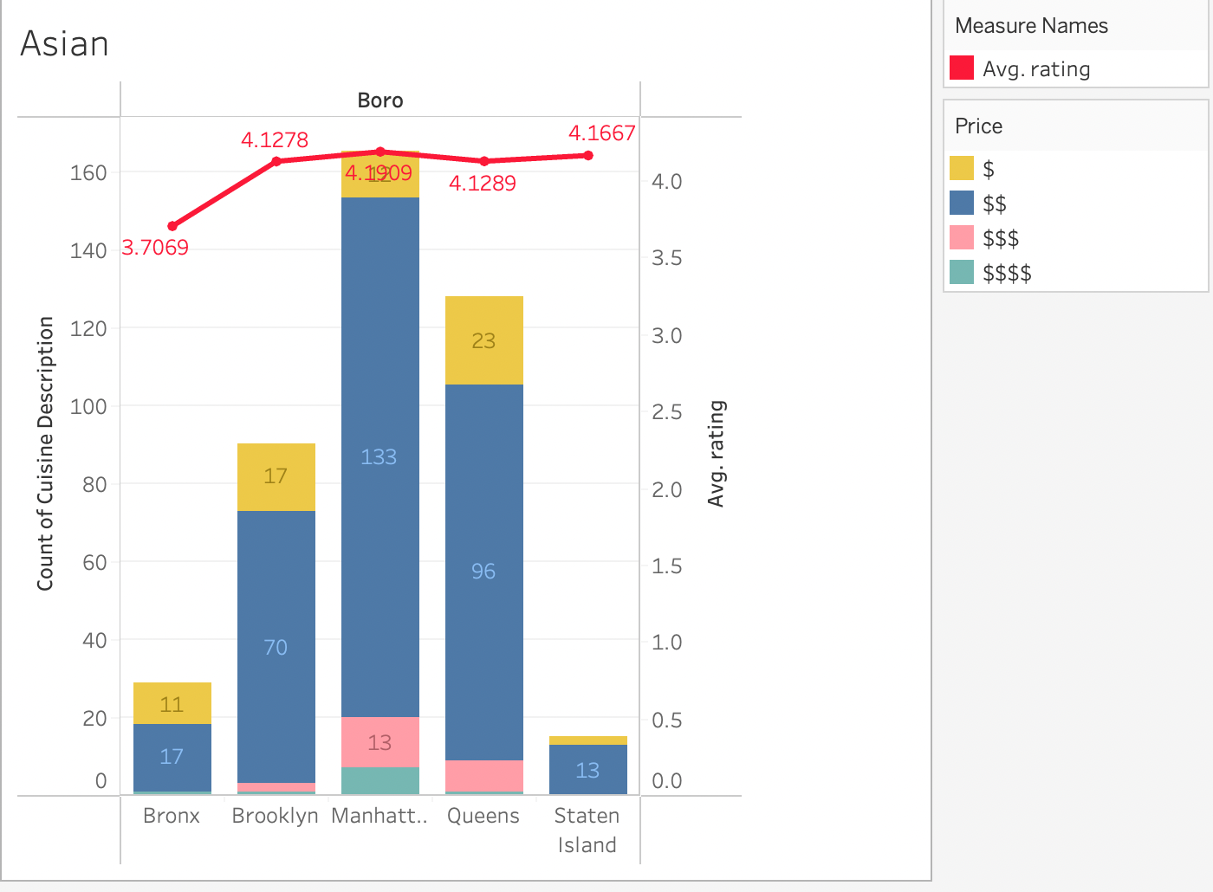

Slide 27
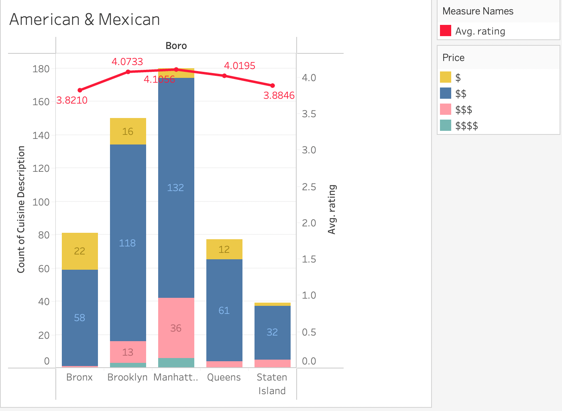

Slide 28
04. RECOMMENDATIONS
& CONCLUSION

Slide 29

Summary
Inspection grade → Focus on the health, safety, and quality
Number of reviews → Encourage customers to make more high-quality comments
Ratings by location → Locate a restaurant in a relatively low rated area where there is less competition
Price range → Determine the price range before starting the restaurant. Locate where there are fewer existing restaurants in the same price range because the presence of multiple restaurants typically indicates a saturated market.
Notes:
Based on the ratings by location, The rating in each borough as well as the smaller area are factors that a new restaurant needs to think about when selecting the location. The recommendation we give is to locate a restaurant in a relatively low-rated location where there is less competition.
In terms of the price, it's important to determine the menu price before starting the restaurant. Besides, as the presence of multiple restaurants in the same price range typically indicates a more saturated market, a new restaurant is better off starting where there are fewer existing restaurants with the same price range.

Slide 30

Borough | Cuisine
Brooklyn | Italian
With 6.1% of total population living in Brooklyn, there is a very high demand for authentic Italian food.
There is not a lot of competition in the area so with the right pricing strategies, it would be much easier to launch.
Focus on the health, quality, and reviews from customers
Notes:
With a large italian immigration population, there is a high demand for authentic Italian cuisine. With the recent opening of Little Italy, the word of mouth for Italian food in Brooklyn helped in opening up new restaurants. The market in Manhattan is saturated and it is quite hard to commute to Queens and Bronx which makes Brooklyn the best place to start the restaurant.

Slide 31

Citations/ References
Lin, Hubert, and Ekim Sarinoglu. “| notebook.community.” | notebook.community,
https://notebook.community/NYUDataBootcamp/Projects/UG_F16/Lin-Sarinoglu-NYC%20Inspection%20Analysis. Accessed 9 May 2022.
Rspiro9. “GitHub - Rspiro9/NYC-Restaurant-Yelp-and-Inspection-Analysis: Used Hypothesis Testing to Gather Analytical Insights about Manhattan Yelp and Inspection Grade Data. Additionally, Used Machine Learning Classification Techniques Such as Logistic Regression, Decision Tree, Random Forest, XGBoost, and Adaboost, to Predict Yelp Ratings for Manhattan Restaurants.” GitHub, github.com/rspiro9/NYC-Restaurant-Yelp-and-Inspection-Analysis#nyc-restaurant-yelp-and-inspection-analysis. Accessed 10 May 2022.

Slide 32
Thank you!

